Slide 1


Slide 2
Technical Note 5
Facility Layout
Notes:
2

Slide 3
OBJECTIVES
Facility Layout and Basic Formats
Process Layout
Layout Planning
Assembly Line balancing
Service Layout
Notes:
2

Slide 4
Facility Layout
Defined
Facility layout can be defined as the process by which the placement of departments, workgroups within departments, workstations, machines, and stock-holding points within a facility are determined
This process requires the following inputs:
  Specification of objectives of the system in terms of output and flexibility
  Estimation of product or service demand on the system
  Processing requirements in terms of number of operations and amount of flow between departments and work centers
  Space requirements for the elements in the layout
  Space availability within the facility itself
Notes:
3

Slide 5
Basic Production Layout Formats
Process Layout (also called job-shop or functional layout)
Product Layout (also called flow-shop layout)
Group Technology (Cellular) Layout
Fixed-Position Layout
Notes:
4

Slide 6
Process Layout: Interdepartmental Flow
Given
  The flow (number of moves) to and from all departments
  The cost of moving from one department to another
  The existing or planned physical layout of the plant
Determine
  The “best” locations for each department, where best means maximizing flow, which minimizing costs
Notes:
6

Slide 7
Process Layout: CRAFT Approach
It is a heuristic program; it uses a simple rule of thumb in making evaluations:
  "Compare two departments at a time and exchange them if it reduces the total cost of the layout."
It does not guarantee an optimal solution
CRAFT assumes the existence of variable path material handling equipment such as forklift trucks
Notes:
8

Slide 8
Process Layout: Systematic Layout Planning
Numerical flow of items between departments
  Can be impractical to obtain
  Does not account for the qualitative factors that may be crucial to the placement decision
Systematic Layout Planning
  Accounts for the importance of having each department located next to every other department
  Is also guided by trial and error
    Switching departments then checking the results of the “closeness” score
Notes:
9

Slide 9
Example of Systematic Layout Planning: Reasons for Closeness
Code
Reason
1
Type of customer
2
Ease of supervision
3
Common personnel
4
Contact necessary
5
Share same price
6
Psychology
Notes:
10

Slide 10
Example of Systematic Layout Planning:
Importance of Closeness
Value
Closeness
Line
code
Numerical
weights
A
Absolutely necessary
16
E
Especially important
8
I
Important
4
O
Ordinary closeness OK
2
U
Unimportant
0
X
Undesirable
80

Slide 11
Example of Systematic Layout Planning: Relating Reasons and Importance
From
To
Area
(sq. ft.)
2
3
4
5
1. Credit department
I
U
A
U
100
6
--
4
--
2. Toy department
U
I
A
400
Note here that the (1) Credit Dept. and (2) Toy Dept. are given a high rating of 6.
--
1
1,6
3. Wine department
U
Note here that the (2) Toy Dept. and the (5) Candy Dept. are given a high rating of 6.
X
300
--
1
4. Camera department
X
100
1
5. Candy department
100
Closeness rating
Letter
Reason for rating
Number

Slide 12
Example of Systematic Layout Planning:
Initial Relationship Diagram
1
E
3
The number of lines here represent paths required to be taken in transactions between the departments. The more lines, the more the interaction between departments.
I
4
U
U
2
5
A
Note here again, Depts. (1) and (2) are linked together, and Depts. (2) and (5) are linked together by multiple lines or required transactions.
Notes:
13

Slide 13
Example of Systematic Layout Planning:
Initial and Final Layouts
5
2
4
2
3
3
1
5
1
4
20 ft
Note in the Final Layout that Depts. (1) and (5) are not both placed directly next to Dept. (2).
50 ft
Initial Layout
Ignoring space and
building constraints
Final Layout
Adjusted by square
footage and building
size
Notes:
14

Slide 14
Assembly Lines Balancing Concepts
Question: Suppose you load work into the three work stations below such that each will take the corresponding number of minutes as shown. What is the cycle time of this line?
Station 1
Station 2
Station 3
Minutes per Unit
6
7
3
Answer: The cycle time of the line is always determined by the work station taking the longest time. In this problem, the cycle time of the line is 7 minutes. There is also going to be idle time at the other two work stations.
Notes:
15

Slide 15
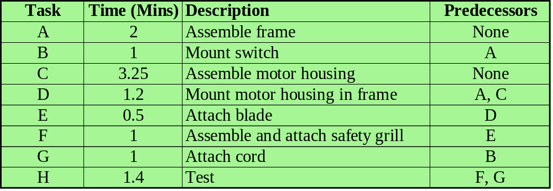
Example of Line Balancing
You’ve just been assigned the job a setting up an electric fan assembly line with the following tasks:

Slide 16
Example of Line Balancing:
Structuring the Precedence Diagram
Task Predecessors
Task Predecessors
A None
E D
B A
F E
C None
G B
D A, C
H E, G
A
B
G
H
C
D
E
F
Notes:
17

Slide 17
Example of Line Balancing: Precedence Diagram
Question: Which process step defines the maximum rate of production?
2
1
1
A
B
G
1.4
H
C
D
E
F
3.25
1.2
.5
1
Answer: Task C is the cycle time of the line and therefore, the maximum rate of production.
Notes:
17

Slide 18
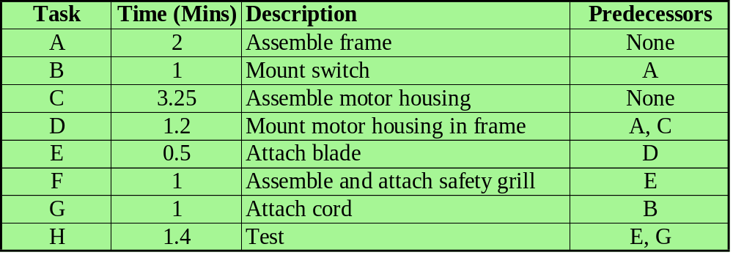
Example of Line Balancing: The Bottleneck
Notes:
18

Slide 19
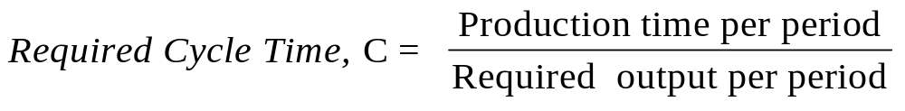
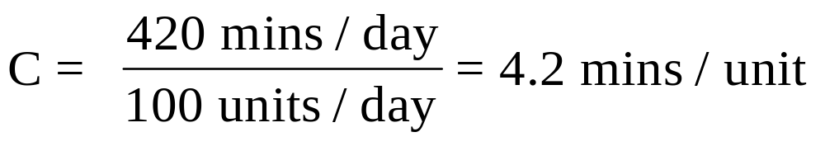
Example of Line Balancing: Determine Cycle Time
Question: Suppose we want to assemble 100 fans per day. What would our cycle time have to be?
Answer:
Notes:
19

Slide 20
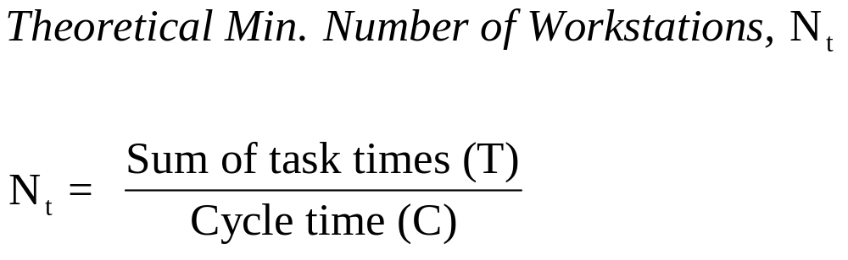
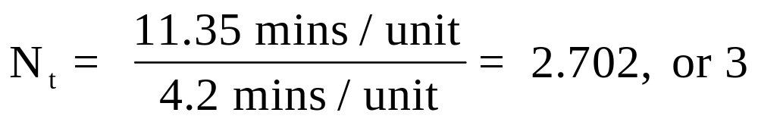
Example of Line Balancing: Determine Theoretical Minimum Number of Workstations
Question: What is the theoretical minimum number of workstations for this problem?
Answer:
Notes:
19

Slide 21
Example of Line Balancing: Rules To Follow for Loading Workstations
Assign tasks to station 1, then 2, etc. in sequence. Keep assigning to a workstation ensuring that precedence is maintained and total work is less than or equal to the cycle time. Use the following rules to select tasks for assignment.
Primary: Assign tasks in order of the largest number of following tasks
Secondary (tie-breaking): Assign tasks in order of the longest operating time
Notes:
21

Slide 22
Task
Followers
Time (Mins)
A
6
2
2
1
1
C
4
3.25
A
B
G
1.4
H
D
3
1.2
B
2
1
E
2
0.5
C
D
E
F
F
1
1
3.25
1.2
.5
1
G
1
1
H
0
1.4
Station 1
Station 2
Station 3
Notes:
23

Slide 23
Task
Followers
Time (Mins)
A
6
2
2
1
1
C
4
3.25
A
B
G
1.4
H
D
3
1.2
B
2
1
E
2
0.5
C
D
E
F
F
1
1
3.25
1.2
.5
1
G
1
1
H
0
1.4
Station 1
Station 2
Station 3
A (4.2-2=2.2)
Notes:
24

Slide 24
Task
Followers
Time (Mins)
A
6
2
2
1
1
C
4
3.25
A
B
G
1.4
H
D
3
1.2
B
2
1
E
2
0.5
C
D
E
F
F
1
1
3.25
1.2
.5
1
G
1
1
H
0
1.4
Station 1
Station 2
Station 3
A (4.2-2=2.2)
B (2.2-1=1.2)
Notes:
25

Slide 25
Task
Followers
Time (Mins)
A
6
2
2
1
1
C
4
3.25
A
B
G
1.4
H
D
3
1.2
B
2
1
E
2
0.5
C
D
E
F
F
1
1
3.25
1.2
.5
1
G
1
1
H
0
1.4
Station 1
Station 2
Station 3
A (4.2-2=2.2)
B (2.2-1=1.2)
G (1.2-1= .2)
Idle= .2
Notes:
26

Slide 26
Task
Followers
Time (Mins)
A
6
2
2
1
1
C
4
3.25
A
B
G
1.4
H
D
3
1.2
B
2
1
E
2
0.5
C
D
E
F
F
1
1
3.25
1.2
.5
1
G
1
1
H
0
1.4
Station 1
Station 2
Station 3
A (4.2-2=2.2)
B (2.2-1=1.2)
G (1.2-1= .2)
Idle= .2
C (4.2-3.25)=.95
Notes:
27

Slide 27
Task
Followers
Time (Mins)
A
6
2
2
1
1
C
4
3.25
A
B
G
1.4
H
D
3
1.2
B
2
1
E
2
0.5
C
D
E
F
F
1
1
3.25
1.2
.5
1
G
1
1
H
0
1.4
Station 1
Station 2
Station 3
A (4.2-2=2.2)
B (2.2-1=1.2)
G (1.2-1= .2)
Idle= .2
C (4.2-3.25)=.95
Idle = .95
Notes:
28

Slide 28
Task
Followers
Time (Mins)
A
6
2
2
1
1
C
4
3.25
A
B
G
1.4
H
D
3
1.2
B
2
1
E
2
0.5
C
D
E
F
F
1
1
3.25
1.2
.5
1
G
1
1
H
0
1.4
Station 1
Station 2
Station 3
A (4.2-2=2.2)
B (2.2-1=1.2)
G (1.2-1= .2)
Idle= .2
C (4.2-3.25)=.95
Idle = .95
D (4.2-1.2)=3
Notes:
29

Slide 29
Task
Followers
Time (Mins)
A
6
2
2
1
1
C
4
3.25
A
B
G
1.4
H
D
3
1.2
B
2
1
E
2
0.5
C
D
E
F
F
1
1
3.25
1.2
.5
1
G
1
1
H
0
1.4
Station 1
Station 2
Station 3
A (4.2-2=2.2)
B (2.2-1=1.2)
G (1.2-1= .2)
Idle= .2
C (4.2-3.25)=.95
Idle = .95
D (4.2-1.2)=3
E (3-.5)=2.5
Notes:
30

Slide 30
Task
Followers
Time (Mins)
A
6
2
2
1
1
C
4
3.25
A
B
G
1.4
H
D
3
1.2
B
2
1
E
2
0.5
C
D
E
F
F
1
1
3.25
1.2
.5
1
G
1
1
H
0
1.4
Station 1
Station 2
Station 3
A (4.2-2=2.2)
B (2.2-1=1.2)
G (1.2-1= .2)
Idle= .2
C (4.2-3.25)=.95
Idle = .95
D (4.2-1.2)=3
E (3-.5)=2.5
F (2.5-1)=1.5
Notes:
31

Slide 31
Task
Followers
Time (Mins)
A
6
2
2
1
1
C
4
3.25
A
B
G
1.4
H
D
3
1.2
B
2
1
E
2
0.5
C
D
E
F
F
1
1
3.25
1.2
.5
1
G
1
1
H
0
1.4
Station 1
Station 2
Station 3
A (4.2-2=2.2)
B (2.2-1=1.2)
G (1.2-1= .2)
Idle= .2
C (4.2-3.25)=.95
Idle = .95
D (4.2-1.2)=3
E (3-.5)=2.5
F (2.5-1)=1.5
H (1.5-1.4)=.1
Idle = .1
Which station is the bottleneck? What is the effective cycle time?
Notes:
32

Slide 32
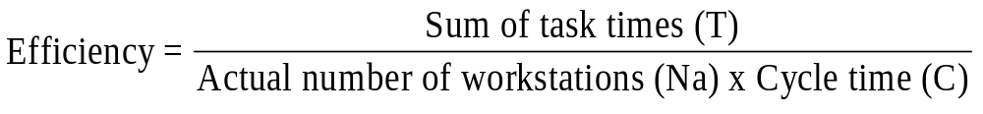
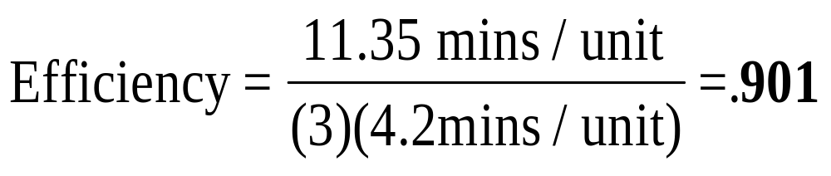
Example of Line Balancing: Determine the Efficiency of the Assembly Line
Notes:
33

Slide 33
Group Technology:
Benefits
1. Better human relations
2. Improved operator expertise
3. Less in-process inventory and material handling
4. Faster production setup
Notes:
34

Slide 34
Group Technology:
Transition from Process Layout
1. Grouping parts into families that follow a common sequence of steps
2. Identifying dominant flow patterns of parts families as a basis for location or relocation of processes
3. Physically grouping machines and processes into cells
Notes:
35

Slide 35

Fixed Position Layout
Question: What are our primary considerations for a fixed position layout?
Answer: Arranging materials and equipment concentrically around the production point in their order of use.
Notes:
36

Slide 36
Retail Service Layout
Goal--maximize net profit per square foot of floor space
Servicescapes
  Ambient Conditions
  Spatial Layout and Functionality
  Signs, Symbols, and Artifacts
Notes:
37

Slide 37
End of Technical Note 5
Notes:
2

